Slide 1
Keystone PCIe Usage
Eric Ding

Slide 2
Agenda
PCIe Overview
Address Translation
Configuration
PCIe Demo

Slide 3
Agenda
PCIe Overview
Address Translation
Configuration
PCIe Demo

Slide 4
PCIe Topology Example
PCIe: A tree structure with nodes connected to each other via point-to-point links.
The root node is called the root complex (RC).
The leaf nodes are called end points (EP) and the nodes that connect multiple devices to each other are called switches (SW).

Slide 5
KeyStone Architecture
Memory Subsystem
Application-Specific
CorePac & Memory Subsystem
64-Bit
MSM
Coprocessors
Memory Expansion
DDR3 EMIF
SRAM
MSMC
Multicore Navigator
Debug & Trace
Network Coprocessor
Boot ROM
External Interfaces
Semaphore
C66x™
SGMII allows two 10/100/1000 Ethernet interfaces
Four high-bandwidth Serial RapidIO (SRIO) lanes for inter-DSP applications
SPI for boot operations
UART for development/testing
Two PCIe at 5 Gbps
I²C for EPROM at 400 Kbps
Application-specific Interfaces:
Antenna Interface 2 (AIF2) for wireless applications
Telecommunications Serial Port (TSIP) x2 for media applications
Power
CorePac
Management
PLL
L1
L1
x3
P-Cache
D-Cache
EDMA
L2 SRAM
x3
1 to 8 Cores @ up to 1.25 GHz
HyperLink
TeraNet
Multicore Navigator
Queue
Packet
Manager
DMA
x2
-
O
x4
t
s
T
n
/
e
h
r
o
I
n
I
i
c
e
C
R
P
t
c
r
t
h
e
a
i
O
Security
h
A
c
f
e
i
2
I
S
i
c
t
I
i
c
I
h
w
Accelerator
C
U
l
e
R
t
O
P
p
p
t
S
i
p
S
S
E
w
A
S
Packet
I
Accelerator
I
M
x2
G
S
Network Coprocessor
Notes:
5
Shannon expands on Nyquist ‘s processing power by doubling the C66x DSP core count to 8. This configuration provides a high performing IP Network Transport solution and excels at the layer 2 and even addresses layer 3 processing requirements of wireless base station while offering significantly lower power consumption than traditional GPPs. Layer 2, 3 and IP network/transport Coprocessor for fast path processing along with Linux support are provided in Shannon resulting in an excellent platform for layer 2 and 3 processing. The Shannon and Nyquist / Turbo Nyquist combination are ideal for large scale Macro base stations.
Using Hyperlink 50 Shannon can also be configured as an extension of Nyquist / Turbo Nyquist. HyperLink 50 is a very low latency (<200ns), high data rate (50 Gbps) interface which is typically used as a bridge Shannon and Turbo Nyquist. In addition to its low latency and high data rate this connection is transparent to the software. A Shannon / Turbo Nyquist pairing can combine into a very high performance 12 core SoC. The Coprocessors can work in a ‘farm’ concept and can be shared between the 12 cores. Multicore Navigator and it’s unified communication capabilities facilitate such ‘coupling’ of devices natively. Optionally the IO can be powered down to reduce the overall power consumption if only the Shannon cores are required.

Slide 6
PCIe Features
PCI-SIG: PCI Express Base Specification (Rev. 2.0)
Root Complex (RC) and End Point (EP) operation modes.
In EP mode, supports both legacy EP mode and native PCIe EP mode.
Set from bootstrap pins PCIESSMODE[1:0] at power-up (00->EP, 01->Legacy EP, 10->RC).
Software overwrites the setting by changing the PCIESSMODE bits in the DEVSTAT register.
Gen1 (2.5 Gbps) and Gen2 (5.0 Gbps)
x2 lanes
Outbound/Inbound max payload size of 128/256 bytes

Slide 7
Agenda
PCIe Overview
Address Translation
Configuration
PCIe Boot Demo

Slide 8
Address Translation
PCIe device uses PCIe address to Tx/Rx packets over a PCIe link.
Outbound transfer means the local device initiates the transactions to write to or read from the external device. The CPU or the device-level EDMA is used for outbound data transfer. The PCIe module does not have built-in EDMA.
Inbound transfer means the external device initiates the transactions to write to or read from the local device. The PCIe module has a master port to transfer the data to or from the device memory; No CPU or EDMA is needed for inbound transfer in the local device.
BAR: used to accept/reject TLP (Transport Layer Protocol).

Slide 9
Outbound Translation - 1
PCIe data space 256 MB (0x6000_0000~0x6FFF_FFFF)
Enable/disable through CMD_STATUS register.
When enabled, the outbound PCIe address (0x6000_0000~0x6FFF_FFFF) can be modified to a new address based on the outbound translation rules.
Equally divided into 32 regions
Registers for outbound (OB):
OB_SIZE: identify the size of 32 equally-sized translation regions to be 1MB/2MB/4MB/8MB
OB_OFFSET_INDEXn (n =0;31): represent bits[31:20] of the PCIe address for 32-bit or 64-bit addressing; not all bits will be used (depend on OB_SIZE); bit[0] enables the outbound region
OB_OFFSETn_HI (n =0;31) : represent bits[63:32] of the PCIe address for 64-bit addressing; must be zero for 32-bit addressing

Slide 10
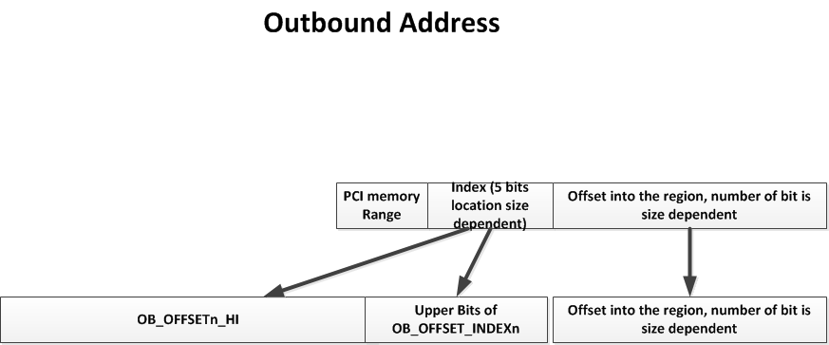
Outbound Translation - 2

Slide 11
Outbound Translation - 3
OB_SIZE | OB_OFFSET_INDEXn
 | Region indexing | Translation
0 (1 MB) | [24:20] | [31:20]
1 (2 MB) | [25:21] | [31:21]
2 (4 MB) | [26:22] | [31:22]
3 (8 MB) | [27:23] | [31:23]
Example:
OB_SIZE: 1 MB;
OB_OFFSET_INDEX0 = 0x9000_0001;
OB_OFFSET0_HI = 0x0;
PCIE data space address: 0x6001_5678;
What is the translated PCIe address?

Slide 12
Outbound Translation - 4
Example continues:
Because OB_SIZE = 1 MB ==➔ using bit [24:20] for region indexing
Thus the index region is 0, and the next 20 bits – bit 0 to 19 determine the offset into the region
Using OB_OFFSET_INDEX0 and OB_OFFSET0_HI
The region upper base address is the OB_OFFSET0_HI = 0 and the upper 12 bits of the OB_OFFSET_INDEX0 register is bits 31:20 of the base address, so the combined based address of region 0 is
0x0000 0000 900 X XXXX
Then the translated PCIe address = bits[31:20] of 0x9000_0000 + bits[19:0] of 0x6001_5678 = 0x9001_5678

Slide 13
Inbound Translation - 1
Enable/disable through CMD_STATUS register
During negotiation, the RC and the EP exchange memory requests. These values are saved in the BAR registers
BARn: two BARs (BAR0~1) in RC mode and six BARs (BAR0~5) in EP mode; Each register overlays initial address and MASK (based on DBI_CS2 bit in the CMD_STATUS register)
BAR0 cannot be remapped to any other location than to PCIe application registers (starting from 0x2180_0000 in KeyStone device). It allows the RC device to control EP in the absence of dedicated software running on EP
During initialization, the values in the BAR are used to build (up to) four memory regions.

Slide 14
Inbound Translation - 2
Each memory region has the following
IB_BAR Inbound Translation Match Register (write the MASK into IB_BAR, read gives the BAR number to match the inbound translation)
IB_START_LO Inbound Translation Start Address Low Register
IB_START_HI Inbound Translation Start Address High Register
IB_OFFSET Inbound Translation device base address
For inbound address A that arrives the following happens:
Using a IB_BAR MASK register, A is compared with the low and high address of BAR 0-5 to see if there is a match
If there is no match, the address is rejected
If there is a match, the internal device address is calculated as follows:
The first BAR number that covers A is determine, then look up in IB_BARn (0-3) to see which IB_BAR has this BAR number
The difference between A – IB_START (64 bit, high and low) is calculated
The result is added to the device base address

Slide 15
Inbound Translation - 3
Example (assume that BAR1 covers the inbound address):
For a 32-bit BAR,
IB_BAR0 = 1 -> BAR1_MASK = 0x000F FFFF
IB_START0_LO = 0xF740_0000;
IB_START0_HI = 0x0;
IB_OFFSET0 = 0x1080_0000
For PCIe address 0xF740_1234, what is the DSP device’s internal address?

Slide 16
Inbound Translation - 4
Example Calculation:
The incoming address of 0xF740_1234 (covered by BAR 1) with the mask 0x000F FFFF gives 0xF740 0000. Matches the address of IB_START1 register, it is accepted, BAR1 is inside IB_BAR0
DSP internal address:
0xF740_1234 - 0x000F FFFF + 0x1080_0000 = 0x1080_1234 (local L2)

Slide 17
Agenda
PCIe Overview
Address Translation
Configuration
PCIe Demo

Slide 18
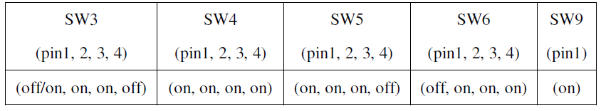
PCIe Initialization
Boot mode: PCIe boot by selecting pins on 6678/6670 EVM boards.
IBL code
PLL workaround (6678 Errata, advisory 8)
Power-up PCIe
Configure PLL
Configure PCIe registers
Waiting for PCIe link-up
Stay inside IBL, monitor the magic address (6678: 0x87FFFC; 6670: 0x8FFFFC) for secondary boot

Slide 19
PCIe Boot

Slide 20
Agenda
PCIe Overview
Address Translation
Configuration
PCIe Demo

Slide 21
Demo
C:\ti\pdk_C6678_xx_yy\packages\ti\drv\pcie\example\sample
Example instructions are in the readme file and in the next slides

Slide 22
Demo
******************************************************************************
* FILE PURPOSE: Readme File for the PCIE Example Project
******************************************************************************
* FILE NAME: Readme.txt
* Copyright (C) 2011, Texas Instruments, Inc.
*****************************************************************************
The example demonstrates the use of APIs provided in PCIE LLD. This example does NOT work
in the Shannon Simulator.
Check the release notes for pre-requisites, tools and version information.
------------------
Example Overview
------------------
In the PCIe sample example two Shannon EVMs are used to test the PCIe driver. As described in the following figure, Shannon 1 is configured as a Root Complex and Shannon 2 is configured as End Point.
Shannon 1 Shannon 2
------------------ ------------------
| | | |
| Root | PCIe Link | End Point |
| Complex | <-------------------------->| |
| | | |
------------------ ------------------

Slide 23
Demo
At startup, each EVM configures its PCIe subsystem:
• Serdes, clock, PLL
• PCIe Mode and Power domain
• Inbound/Outbound address translation and BAR registers
• Link training is triggered
Once the PCIe link is established, the following sequence of events will happen:
• Shannon 1 sends data to Shannon 2
• Shannon 2 waits to receive all the data
• Shannon 2 sends the data back to Shannon 1
• Shannon 1 waits to receive all the data
• Shannon 1 verifies if the received data matches the sent data and declares test pass or fail.

Slide 24
Demo
-------------------------
Steps to run the example
-------------------------
1. Build the example
2. Do a System Reset in both EVMs
3. Load exampleProject.out in core zero in both EVMs
4. In Shannon 1, use CCS watch window to modify the value of global
variable PcieModeGbl. In this example, Shannon 1 is a Root Complex,
therefore set PcieModeGbl to pcie_RC_MODE (this can be done through a drop down
menu in the watch window).
5. Click the "Run" button in CCS for both EVMs (it is okay to have a few seconds between
the "Run" buttons are clicked in both sides).

Slide 25
Demo
-------------------------
Expected result
-------------------------
1. In Shannon 1 CCS console the status of the test will be updated. At the end, the message
"Test passed" is expected.
2. In Shannon 2 CCS console the status of the test will be updated. At the end, the message
"End of test" is expected.

Slide 26
For More Information
For more information, refer to the PCI Express (PCIe) for KeyStone Devices User’s Guide.
For questions regarding topics covered in this training, visit the support forums at the TI E2E Community website.
Notes:
NEW

